Slide 2
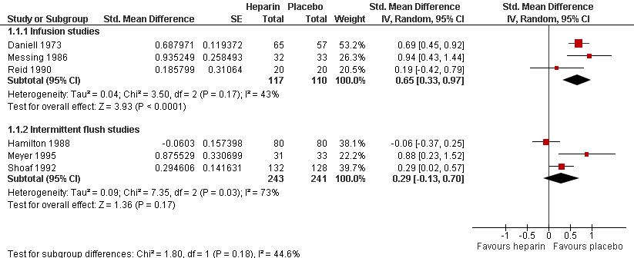
Figure 2: Meta-analysis of data for catheter patency (in SMD units).

Slide 3
Figure 3: Patency at fixed time intervals (at 48 and 72 after starting infusion)

Slide 4
Figure 4: Heparin versus Control- Outcome of Infusion failure

Slide 5
Figure 5: Heparin versus Control- Outcome of Phlebitis

Slide 6
Supplementary data 1: Meta-analysis of data for catheter patency (in hours)

Slide 7
Supplementary data 2: Patency at 48 hours: Sensitivity analysis for one catheter/subject data and all catheter data

