Slide 1
Fig.1.: Respiratory Carbon monoxide excretion: Expired carbon monoxide was measured in obese and lean ZR. It was higher in awake obese ZR compared to the lean group (*P<0.05). Values are expressed as mean ± SE.

Slide 2
Fig.2.: Plasma nitrite levels: Nitrites are the breakdown products of nitric oxide. The nitrite levels in plasma are decreased in obese ZR (*P<0.05). Values are expressed as mean ± SE.

Slide 3
Change in Diameter - Vehicle
Fig.3.: Vessel Diameter: Concentration dependent change in internal diameter of septal coronary arteries in response to endothelium dependent vasodilator, ACh and when treated with vehicle and L-arginine, substrate for nitric oxide in obese ZR. Vasodilation was observed in L-arginine treated group compared to vehicle treated (*P<0.05). Values are expressed as mean ± SE.

Slide 4
Fig.4.: Vessel Diameter: Concentration dependent change in internal diameter of septal coronary arteries in response to endothelium dependent vasodilator, ACh during pretreatment with an inhibitor of heme oxygenase, chromium mesoporphyrin (CrMP). ACh induced vasodilation was greatly attenuated in obese ZR compared with lean group. No significant difference was observed in CrMP treated and vehicle treated groups (*P<0.05). Values are expressed as mean ± SE.

Slide 5
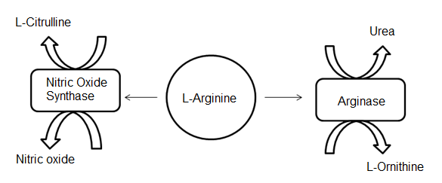
Fig.5.: L-Arginine, common substrate for both arginase and nitric oxide synthase. L-Arginine is converted to urea and L-ornithine by the arginase enzyme along with nitric oxide and L-citrulline by nitric oxide synthase.

Slide 6
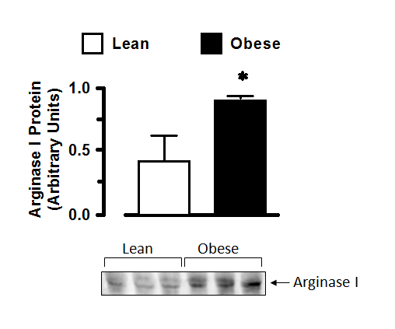
Fig.6.: Arginase I expression: Western blot analysis of Arginase 1 expression in coronary arteries. A significant increase in aortic arginase levels was observed in obese ZR compared to lean ZR (*P<0.05). Values are expressed as mean ± SE.

Slide 7
Fig.7.: Vessel Diameter: Concentration dependent change in internal diameter of septal coronary arteries in response to endothelium dependent vasodilator, ACh during pretreatment with L-arginine, substrate for NOS. L-Arginine greatly increased the vasodilatory responses in the obese ZR as compared to vehicle treatment (*P<0.05). Values are expressed as mean ± SE.

Slide 8
Fig.8.: Vessel Diameter: Concentration dependent change in internal diameter of septal coronary arteries in response to endothelium dependent vasodilator, ACh during pretreatment with L-arginine, substrate for NOS. This treatment with L-arginine abolished the differences between lean and obese ZR.

Slide 9
Table 1:Various metabolic parameters.
Variable | Lean Zucker Rat | Obese Zucker Rat
MAP (mmHg) | 121 ± 4 | 154 ± 3*
Heart Rate (bpm) | 353 ± 10 | 386 ± 7
HbCO% | 3.0 ± 0.1 | 3.9 ± 0.1*
Blood Glucose (mg/dL) | 140 ± 3 | 186 ± 7*
Table 1: Various metabolic parameters: Mean Arterial Pressure (MAP), Heart rate, carboxyhemoglobin and blood glucose of obese Zucker rats was higher than lean ZR (*P<0.05). Values are expressed as mean ± SE.

Slide 10
Table 2: Physical Measurements of Lean and Obese ZR.
Variable | Lean Zucker Rat | Obese Zucker Rat
Body Weight (g) | 309±14 | 551±13*
Kidney Weight (g) | 1.03±0.04 | 1.38±0.04*
Heart Weight (g) | 0.87±0.08 | 1.15±0.04*
Table 2: Physical measurements of obese and lean ZR: Body, kidney and heart weights were higher in obese ZR as compared to lean ZR (*P<0.05).Values are expressed as mean ± SE.

